Slide 1
Prehistory, the Neolithic Revolution, and River Civilizations
Notes:
Um, approximate!! 7 MYA diverge (bentley says 5M), 3.5 MYA bipedal, not until 50K great leap fwd
Prehistory- means before writing, so we’re working here in anthropology and archaeology

Slide 2
BIG PICTURE: Development of agriculture a MAJOR CHANGE in human history. Most societies were agricultural. Still a clash between industrialized world and agricultural patterns.

Slide 3
I. Human Evolution
Emergence of humans 2.5 million BCE – 9,000 BCE – Hunter - Gatherers
Earliest versions of humans from East Africa (Olduvai Gorge)
Use of tools and domestication of animals
Homo sapiens sapiens (H.s.s.) – 120,000 years ago
Migration around the world – resources
25,000 BCE – H.s.s. spread around the world (few exceptions)
Notes:
Leakey’s, 1960’s, east africa/tanzania- might have been asia but leakey’s stopped that- lucy named after beatles
Evolution often a byproduct of climate change- first instance of human interaction with environment
98.5 % chimpanzee!
EVOLUTION HANDOUT
GOODALL VIDEO!!!
*interesting note about race: white people would have evolved to lose pigment/be more susceptible to the effects of the sun because they weren’t getting enough vitamin D in their bodies, so they needed the sun
Erectus- fire- hunters worked in groups
Distinguished from other primates by:
Bipedalism
Larger brain
Larynx (voicebox)
Hunter – gatherer societies require as much as 2.5 square miles of space per person
H.s.s. still didn’t occupy New Zealand, Bermuda, and some Pacific Islands
Discussion: “The fact that similar art and tools were produced over wide areas and long periods of time demonstrates that skills and ideas were not simply individual but were deliberately passed along within societies. These learned patterns of action and expression constitute culture. Culture includes material objects, such as dwellings, clothing, tolls, and crafts, along with nonmaterial values, beliefs and languages. Although it is true that some animals also learn new ways, their activities are determined primarily by inherited instincts. Among humans the proportions are reversed: instincts are less important than the cultural traditions that each new generation learns. All living creatures are part of natural history, which traces biological development, but only human communities trace profound cultural developments over time. The development, transmission, and transformation of cultural practices and events are the subject of history.”
Does culture override instinct?

Slide 4
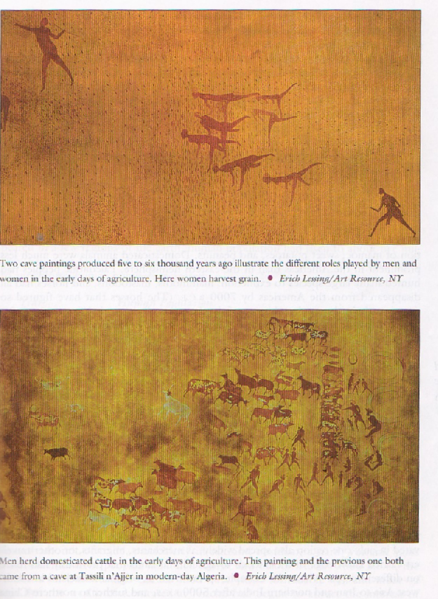
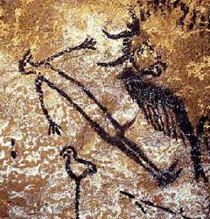

Slide 5
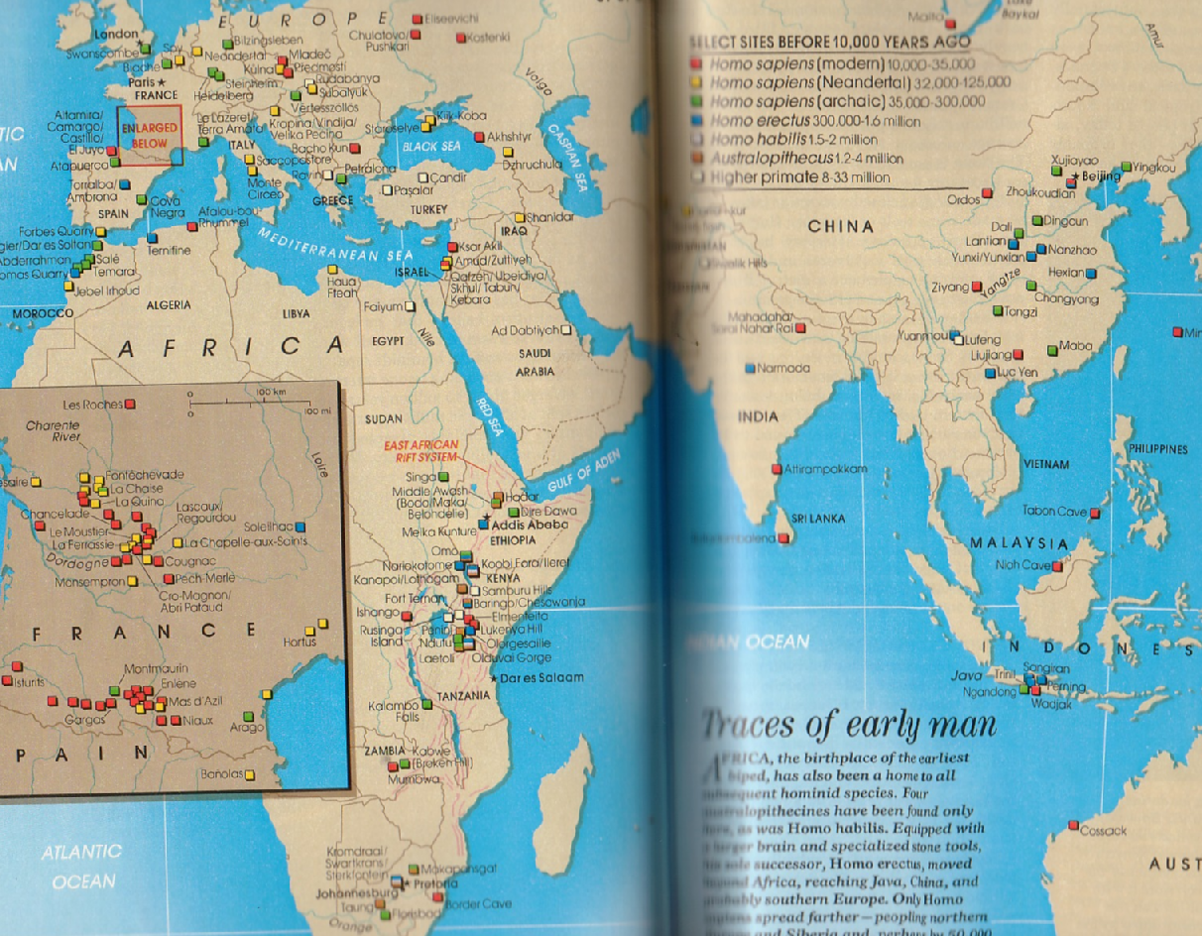
Early Human Sites

Slide 6
II. Neolithic (Agricultural) Revolution
People spread out and formed distinct cultures based on their environment
10,000 – 9,000 BCE – 5 – 10 million people
H.s.s. coexisted with other species (Neanderthals) but eventually triumphed over them
Development of Agriculture and Industrial Revolution – two MAJOR changes
Notes:
Easiest way to survive- small group, but enough to go hunting together for big animals- as they got better, made many animals extinct
Need two parents- one to get food and one to stay with kid- humans more productive-
Women=ag, kids, men= hunting- but both only worked maybe 3 days/week
Relative equality between the sexes
Women were accomplished and respected in society- very good at weaving, textile production- linen esque- must have been important- took time to carve it- maybe even female carvers
Many matrilineal neolithic societies- ancient china. Some even today!

Slide 7
Agricultural Roots
Middle East/Black Sea -9000 – 8000 BCE | Wheat and barley
South China/Continental Southeast Asia – 7000 BCE | Rice
Central America – 5000 BCE | Maize (corn)
POSSIBLY Sub – Saharan Africa and Northern China

Slide 8
III. Changes from Neolithic Revolution
5000 BCE – agriculture common but slow – disadvantages
Few contacts among far – flung population
Environment not suitable (desert, heavy forest)
Success of nomadic herding in some regions
Staying in one place…waiting…
GREATER WORK LOAD

Slide 9
Gender relations changed – patriarchal societies
Higher birthrate necessary
Men primary cultivators
Inequalities between men/women
Settled, clustered groups at higher risk of disease
Altered local environments (slash and burn)
INCREASE IN FOOD SUPPLY RESULTED IN INCREASED POPULATION
Agricultural societies – 80/20
Spring and divine creation
Surpluses - pottery
Notes:
Agricultural economies constrained by limitations in the amount of food each worker could generate so you needed around 80% of population to be working in agriculture. Limits the amount of taxation that could be collected and kept cities to no more than 20% of population.
Surpluses allowed other members of society to specialize in different things – like manufacturing pottery and other technologies.

Slide 10
WHY?
Why would perfectly happy and healthy hunter-gatherers have settled down to be farmers? What processes encouraged this transition?
How do periods of cold and warm weather affect human development?
Notes:
Began cultivating little gardens at rest stops -> planting lots -> wanting to stay & build -> private property -> fighting… saw that animals would stay closer with intentional feeding ->populations boom, began building bigger settlements -> community projects like irrigation -> surplus -> leaders
Needed clothes, needed housing, needed fire, cold enables migration across land bridges, warm enables agriculture, change hunting and gathering methods- need to adapt!!! (think!) as they get smarter, figure out environment- AND MOVE!!! Ice age gets rid of farmland in the Sahara desert…

Slide 11
IV. Early Civilizations
Why Rivers?
Agriculture- dependable water supply
AND stuff already grows there
Domesticated animals
Ability to settle
More temperate climate
Irrigation possible- plays a big role in emergence of civilizations
Notes:
Early civilization = 3500 BCE – 1000 BCE, beforehand, agriculture resulted in isolated cities

Slide 12
A. Mesopotamia
First “civilization”= Sumeria, 5,000 BCE
Tigris & Euphrates – large agricultural surplus
Later, Akkad (empire 2340 BCE), Babylon (early 2nd millenium BCE)
Used bronze – improved military, required long distance trade
Wheel (Central Asian nomads)
Notes:
Define civilization- writing? Ag? Big buildings? Government? Social structure? Specialization?
3rd dynasty of UR, Babylon- conquered by Kassites and Hittites -1600’s bce
Akkad- semitic, Sumer- no, Babylon- Amorites (old babylonian)
Wood, metals, stone

Slide 13
Mesopotamian firsts
First because:
Writing - cuneiform (long distance comm., trade, knowledge passed on)
City-states, formal/structured government
Monumental architecture (ziggurat)
Military strategies and armor
Irrigation (need rules to regulate)
Not first, but remembered for:
Law code of Hammurabi (c. 1750 BCE)
Notes:
Maybe egypt first on the writing, not first to have cities
Epic of Gilgamesh , Astronomy and math and accounting
LUGAL- big man
Ziggurats
Important to note that continuity exists from mesopotamian state to mesopotamian state- law code of hammurabi, religion, iron, etc.
Barley a favored crop – could tolerate Mesopotamian climate, withstand salt

Slide 14
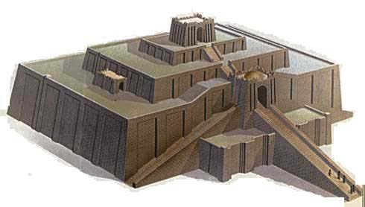
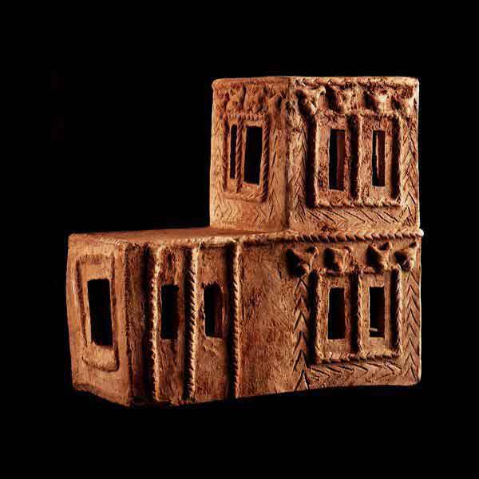
Mesopotamia
Notes:
Mud mud mud- clay model of a house in UR

Slide 15
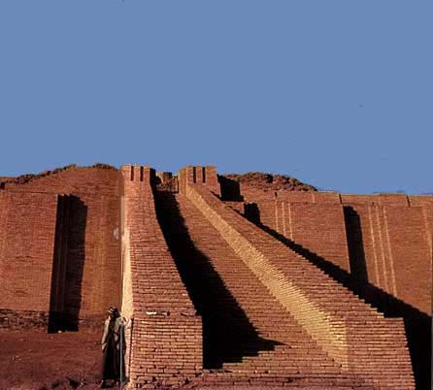
Notes:
VIDEO!!!

Slide 16
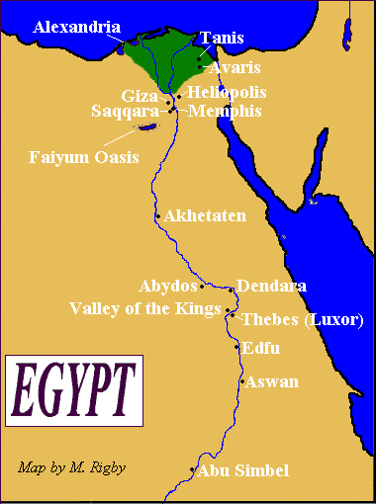
B. EGYPT- Gift of the Nile
MIGRATION ~5000 BCE to Nile- ran out of water in Sahara
Civilization emerged 3000 BCE
Nile – very regular, viewed as a benevolent god
Made Egypt hugely productive
Creation myths – flood cycle
5X the area of France, 6M years old
Notes:
3 harvests/year
rural

Slide 17
Increasing population needs greater political organization
Larger % of pop. lived in farming villages than cities
Ethnically diverse
Less stark social divisions than Mesopotamia
Women had more mobility (esp. upper class)

Slide 18
Social Pyramid
PHAROAH
PRIESTS
NOBLES
MERCHANTS/ARTISANS
PEASANTS
SLAVES

Slide 19
Politics
Three major periods:
OLD KINGDOM 2700 B.C. to 2200 B.C.
MIDDLE KINGDOM 2050 B.C. to 1652 B.C.
NEW KINGDOM 1532 B.C. to 1070 B.C. (height)
Major rulers:
Old Kingdom: Narmer (Menes), Khufu, Khafra, Menkure
New Kingdom: Ramses II, Hatshepsut, Akhenaten
Notes:
Hatshepsut- TRADE!!!!

Slide 20
Religion
Re (Sun god), Osiris, Isis - reincarnation (Egyptian Book of the Dead) – Papyrus
Pharoahs divine (Horus)
Pyramids, mummies – postmortem judgment
Gods of conquered territories incorporated

Slide 21
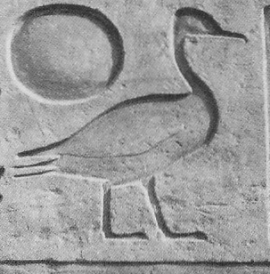
Hieroglyphs
Hieroglyphic pictograms can be read in up to three different ways:
they can represent exactly what they look like
they can represent an idea (i.e. son of), or
they can represent a sound (sa)
Written script
Spoken language
Hieroglyphs (formal writing) | Ancient Egyptian
Hieratic (cursive ‘handwriting’)
Demotic (evolved from hieratic) | Demotic
Coptic (evolved from Demotic, uses Greek characters) | Coptic

Slide 22
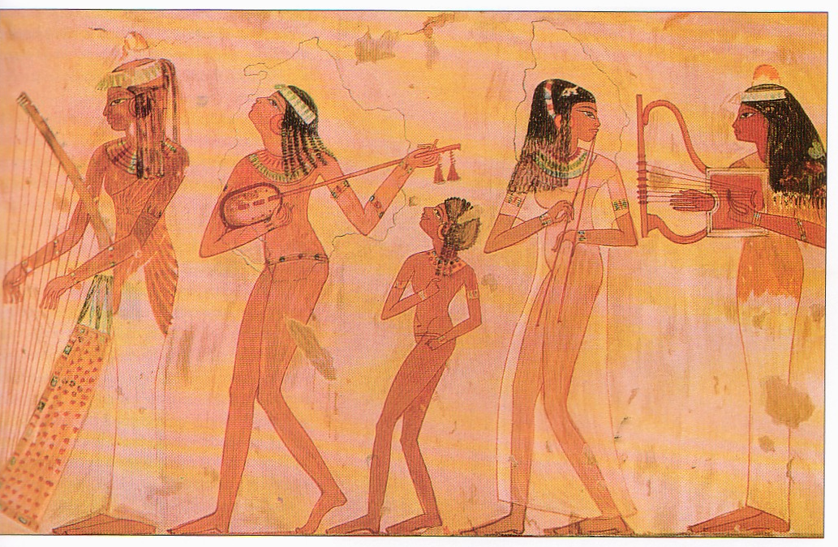
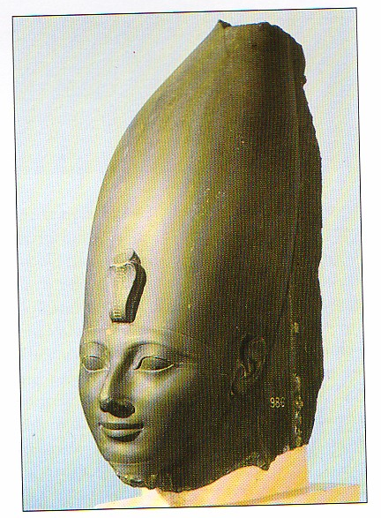

Slide 23
C. INDUS VALLEY
2500 BCE – Major cities Harappa and Mohenjo – Dara (now underwater)
Written language (still uncoded) – lots of Qs
Architecture indicates strong central authority
Indus River was very unpredictable- flooded the cities frequently, also frequent monsoons
Trade with north and west – tools/stones of high quality/value
Fell before the invasions of Indo – Europeans (natural disaster? “systems failure”?)
Notes:
Harappa a major city in Indus River Valley in present Pakistan
Monsoons
Water flowed from the Kush and Himalaya mountains

Slide 24
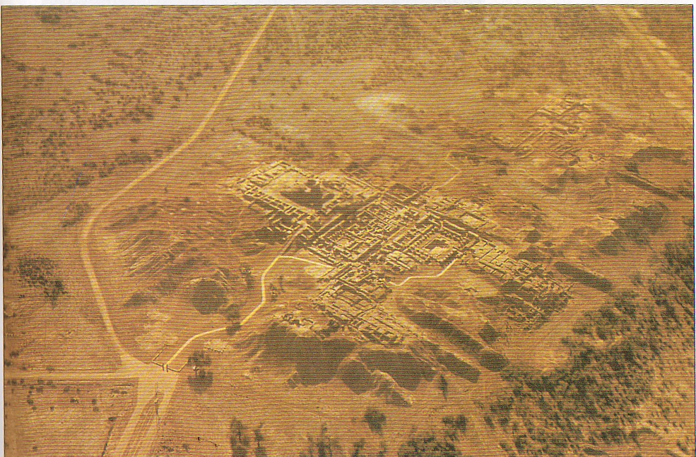
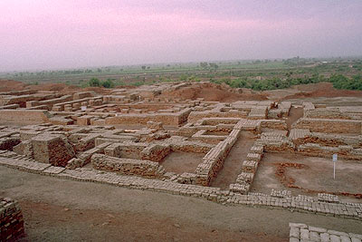
Mohenjo-Daro & Harappa
Notes:
Bigger than Mesopotamia or Egypt, Traders (w/china), More than 80 villages discovered in the area- all modeled on Mohenjo-Daro and Harappa- urban planning! All right angles, all exact same size brick

Slide 25
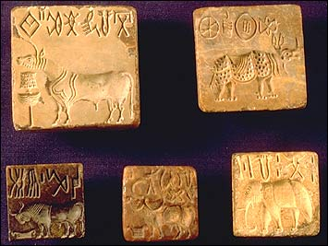
Notes:
Can’t read writing- which is also a reason that we don’t know exactly what caused the downfall – previously, thought possibly aryans, but since refuted

